Slide 1
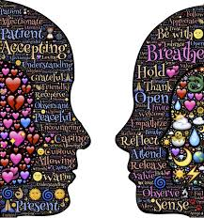
ACT I Workshop two-Day Introduction to acceptance and commitment therapy
Lou Lasprugato, MFT
ACBS ACT Trainer
Notes:
Image: pixabay.com

Slide 2
Act roots
Philosophy: Functional Contextualism (FC)
Science: Contextual Behavioral Science (CBS)
Technology: Applied Behavior Analysis (ABA)
Theory: Relational Frame Theory (RFT)
Application: Acceptance and Commitment Therapy (ACT)

Slide 3
ACT is like driving a car
FC, RFT, ABA - how the engine works
“You can drive well without knowing anything about the engine. However, if you do know something about the engine, you’ll be better equipped and prepared should your car break down.” - Russ Harris
Image: pixabay.com

Slide 4
Contextual behavioral science
Scientific study/application of Functional Contextualism to human behavior
Behavior as the interaction between whole organism and environment defined situationally and historically
Situationally - current private and public events (i.e. setting, experience)
Historically – individual/socio-cultural learning and evolutionary origins

Slide 5
Act Philosophy: fC
Functional Contextualism
A contextualistic interpretation and extension of B.F. Skinner’s radical behaviorism first delineated by Steven Hayes in the 1980s
Philosophy concerned with how psychological events function in specific contexts
Emphasis on function over form of behavior

Slide 6
function over form
Example: cutting on forearm (form of behavior)
Context | Function
Feeling neglected | Getting attention
Fused with “I’m bad” | Self-punishment
Stress as “intolerable” | Release of tension
Emotions as “too painful” | Distract from emotions
Viewing body as canvas | Creating body art
Feeling numbness | Trying to feel something

Slide 7
Philosophy of FC
No thought, feeling, or memory is inherently problematic, dysfunctional, or pathological
Thoughts and feelings don’t cause behaviors, except only as regulated by context
Emphasis on context over content of private events (thoughts, feelings, etc.)

Slide 8
Context over content
Are these emotions functionally “negative”?
Emotion | Context
Fear | Presence of physical or social threat
Anger | Mobilize energy to neutralize threat
Sadness | Loss of someone or something
Guilt | Acting incongruently with values
Shame | Indicator of social cost and need to repair

Slide 9
Goal of fc
To predict and influence behavior with precision, scope, and depth
Precision - specifically targeted processes
Scope – widely applicable
Depth – coherent with other levels of scientific analyses (e.g. biological, cultural, evolutionary)
In ACT, goal is to enable mindful-valued living

Slide 10
workability
The truth criterion in ACT is workability
Workability refers to how effective behavior is in moving one towards a meaningful and fulfilling life
NOT invested in viewing behavior as right-wrong, good-bad, or true-false
This can lead to never-ending debates

Slide 11
Act Technology: aba
Applied Behavior Analysis
Technology for predicting and influencing behavior, based on learning theory and behavioral principles
ABA tool: Functional Analysis
Analyze function of behavior via ABCs
Antecedents-Behavior-Consequences

Slide 12
Abc Analysis
Antecedents
Conditions preceding behavior
Behavior
Observable measurable response
Consequences
Outcomes Reinforcement Punishment
Knowing A and C (context) tells us function of B

Slide 13
Reinforcing Consequences
Reinforcement: consequence that increases future frequency of behavior
Positive reinforcement
Access something you want
Behavior is under appetitive control
Negative reinforcement
Avoid something you don’t want
Behavior is under aversive control

Slide 14
Behavior under aversive control
Antecedents
Alone at night, anxious, urge to drink/use
Behavior
Drinks alcohol or smokes THC
Consequences
Relief from anxiety and cravings
Function of behavior is to avoid (get away from) the antecedents

Slide 15
Behavior under appetitive control
Antecedents
Alone at night, anxious, urge to drink/use
Behavior
Call friend
Go to meeting
Consequences
Relational
Fulfillment
Mindful of antecedents
Contact value of connection
Function of behavior is to move toward relational values

Slide 16
Not so Dichotomous
Behavior is often under both appetitive and aversive control
E.g. Call friend when alone at night
Am I moving toward connection or away from loneliness?
E.g. Drink alcohol when bored
Am I moving toward feeling buzzed or away from boredom?

Slide 17
What About Punishment?
Punishment: consequence that decreases future frequency/likelihood of behavior
Two areas of interest in ACT:
Punishment that interferes with valued living
E.g. criticized or abused for being assertive
Increasing saliency of costs associated with unworkable/ineffective behavior
E.g. social avoidance resulting in isolation

Slide 18
Aims of abc Analysis
Identify clinically relevant behavior
Assess workability of behavior
Activate behavioral change by increasing functional contextual awareness (i.e. aware of what influences one’s behavior)
Shaped by observing, describing and tracking behavioral contingencies (ABCs)

Slide 19
ACT theory: RFT
Relational Frame Theory
Modern behavior analytic approach that proposes human language and cognition is based on ‘relating’
Any objects or events that are relationally framed become verbal – part of the world as known through relational frames
Hayes, et al., 2001
Notes:
Hayes, S. C., Fox, E., Gifford, E. V., Wilson, K. G., Barnes-Holmes, D. & Healy, O. (2001). Derived relational responding as learned behavior. In S. C. Hayes, D. Barnes-Holmes & B. Roche (Eds.) Relational frame theory: A post-Skinnerian account of human language and cognition. New York: Plenum Press.

Slide 20
RFT: Made Simple
Relating (i.e. relational framing) is simply responding to one thing in terms of another
Apple is a type of ______
Apple is same color as ______
Apple is bigger than ______
Apple is different from ______
Apple a day keeps the doctor ______

Slide 21
Types of relational frames
Coordination | Hierarchical
Sameness / similarity | Class membership
Comparison | Deictic
More-less / better-worse | I-you / here-there / now-then
Distinction/Opposition | Temporal
Different from / Opposite of | Before-after
Spatial | Causal/Conditional
Near-far / front-back | Cause-effect / if-then
“Those skills are the source of our greatest human
achievements and of much of our misery.”
Hayes, 2017
Notes:
Quote excerpted from “Finding the Key” article by Steven Hayes, June 2nd, 2017

Slide 22
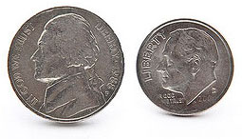
Intrinsic vs Symbolic relations
Relations can be intrinsic (nonarbitrary/physical) or symbolic (arbitrary/language)

Slide 23
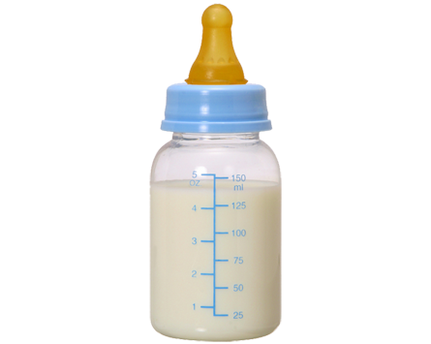
trained vs derived relations
Relational learning begins early childhood
Relations can be trained or derived
“baba”
“milk”
trained
derived
Notes:
Image: foxylearning.com

Slide 24
Deriving Relations of ‘Self’
Arbitrarily Applicable Relational Responding
Transformation of Stimulus Functions
“Not good enough”
trained
derived
Notes:
Image: foxylearning.com

Slide 25
properties of rft
Mutual entailment
If A=B, then B=A (stimuli)
Combinatorial entailment
If A=B and B=C, then A=C
Transformation of functions
The function of one event in a relational network is altered by the functions of another event in the network and the derived relation between them
Notes:
Transformation e.g. – liquid multi was aversive to Sage, then when new stimuli (eye drops) were introduced, which was more aversive, the liquid multi became less aversive (more appetitive) in comparison (distinctive framing) to eye drops

Slide 26
RFT: mutual entailment
A defining feature of relational frames
Relations between stimuli are bidirectional
Image: cognitivedefusion.tumblr.com
Notes:
Image: cognitivedefusion.tumblr.com

Slide 27
Rft: combinatorial entailment
2nd defining feature of relational frames
Responding to two combined relations can entail a response to a third relation
Image: cognitivedefusion.tumblr.com
Notes:
Image: cognitivedefusion.tumblr.com

Slide 28
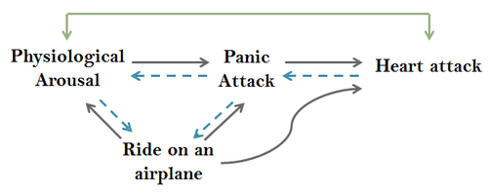
Generating Relational Networks
Transformation of Stimulus Functions
Image: cognitivedefusion.tumblr.com

Slide 29
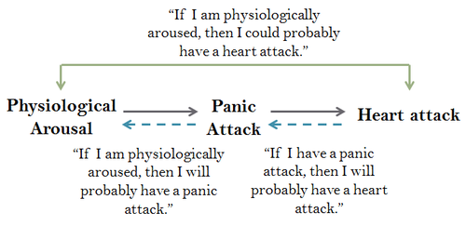
Deriving Rules via Causal Relations
Image: cognitivedefusion.tumblr.com

Slide 30
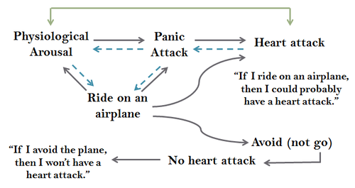
Increasingly Complex Relational Networks
Aversive and Rule-Governed Behavior
Image: cognitivedefusion.tumblr.com

Slide 31
Deriving and Following Rules
Deriving Rules:
Conditional (if-then) statements that connect actions to anticipated consequences
If I do/don’t X, then Y will/won’t happen
Following Rules:
Learn quickly (with potential loss of flexibility)
LEGOs, recipes, working, parenting, etc.
Evoke tracking of actual consequences

Slide 32
Human Language: double-edged sword
Bright Side
Dark Side
Learn without doing
Reflect and extract
Plan ahead
Imagine and invent
Describe and compare
Communicate
Solve (world) problems
Rigidly follow rules
Ruminate
Worry
Confabulate
Judge and criticize
Communicate ineffectively
Experiential Avoidance
Image: freestockphotos.biz

Slide 33
Problem-Solving in ACT
In ACT, any problem-solving occurs out in the world, guided by values
‘Symptom reduction’ is NOT a goal of ACT
Instead, aim is to fundamentally transform our relationship with thoughts & feelings
Altering the context in which these private events occur transforms their function

Slide 34
Transforming function in ACT
In context of mindfulness, painful thoughts and feelings previously judged as ‘problematic’ or ‘symptoms’ become nothing more or less than transient private experiences
In context of values (a life that matters), painful thoughts and feelings = “I care”

Slide 35
AcT: Simply Put
Pronounced as the word ‘ACT’
Accept one’s private experiences
Choose a valued life direction
Take action
Image: pxhere.com

Slide 36
ACT: Technically Speaking
A ‘third wave’ behavioral therapy that is “particularly sensitive to the context and functions of psychological phenomena, not just their form, and thus tends to emphasize contextual and experiential change strategies in addition to more direct and didactic ones”
(Hayes, 2004)
Notes:
Hayes, S. C. (2004). Acceptance and Commitment Therapy, Relational Frame Theory, and the third wave of behavior therapy. Behavior Therapy, 35, 639-665.

Slide 37
Waves of Behavioral Therapy
1st wave: established learning principles
Classical and operant conditioning
Pavlov, Watson, Wolpe, Skinner
2nd wave: information processing (cognition)
CBT and REBT
Aaron Beck, Albert Ellis
3rd wave: contextual/experiential processes
ACT, DBT, other mindfulness-based approaches

Slide 38
Contextual Behavioral Approach
E
Experiential
Orienting toward, relating to, and deriving from experience
P
Pragmatic
Responding to what is useful, practical, and/or meaningful
I
Integrative
Approaching language in a cumulative and coherent manner
C
Contextual
Altering the context to transform stimulus function
Adapted from Villatte, M., Villatte, J. L., & Hayes, S. C. (2015). Mastering the clinical conversation: Language as intervention. Guilford Publications.
Notes:
Experiential: facilitating the observing, describing, and tracking of contingencies influencing behavior across time, space, and person - as opposed to being overly didactic
Metaphor: teaching someone how to fish compared with offering fish to someone who’s starving (depends upon context)
Pragmatic: relating to experiences via workability (functional coherence) as opposed to only what’s socially expected (social coherence, pliance) or intrinsically/objectively true (essential coherence); increases agency/autonomy
“How does holding tightly to this thought impact your life?” or simply, “How has that worked for you?”
Integrative: building and expanding relational networks (“yes AND…”) as opposed to attempting to suppress, replace, or debate
”So, there’s this thought that…AND what else do you notice?”
Contextual: focusing on context over content (i.e. how one relates to or behaves in the presence of thoughts, feelings, etc.)
“Can you allow this feeling to be here, as it is? How would you respond to a loved one who was experiencing this feeling?”

Slide 39
ACT Training Model
Psychological Flexibility
Approach:
Experiential Pragmatic Integrative Contextual
Analysis:
Antecedents Behaviors Consequences
Interventions:
Modeling Evoking Reinforcing
Intrapersonal
Interpersonal
Lasprugato, 2018

Slide 40
Psychological inflexibility
Core conception of ACT
Psychological suffering is caused by the inflexible interface between human language/cognition and ineffective behavior
Relatively narrow, inflexible patterns of behavior that are insensitive to context
Wilson & DuFrene, 2008

Slide 41
Dominance of Past or Future Content
Experiential
Avoidance
Lack of Values
Contact/Clarity
Psychological
Inflexibility
Cognitive
Fusion
Ineffective Action
Attachment to the Conceptualized Self

Slide 42
Psychological inflexibility
Found in studies to predict:
Higher anxiety
Anxiety sensitivity
Excessive worry
Increased depression
Substance abuse
Alexithymia
PTSD and BPD severity*
More overall pathology
Poor work performance
Inability to learn
Lower quality of life
Long-term disability
Kashdan & Rottenberg, 2010
* Chawla, Neharika, & Ostafin, 2007
Notes:
Kashdan, Todd B., and Jonathan Rottenberg. "Psychological flexibility as a fundamental aspect of health." Clinical psychology review 30.7 (2010): 865-878.
Chawla, Neharika, and Brian Ostafin. "Experiential avoidance as a functional dimensional approach to psychopathology: An empirical review." Journal of clinical psychology 63.9 (2007): 871-890.

Slide 43
Inflexibility: fusion
Fusion: domination of verbal (symbolic) stimuli over other forms of behavioral influence
Stuck in the world of language
Hooked or pushed around by thoughts
Taking thoughts literally
Often related to past and/or future content
Loss of contact with here-and-now

Slide 44
Fusion: Topography vs Function
Consider how fusion shows up across various diagnostic categories:
Anxiety, Depression, Addiction, Psychosis, PTSD, BPD, OCD, etc…
Same process, just different content
In ACT, we target process over content, and function over form

Slide 45
Attachment to the conceptualized self
The Conceptualized Self
Descriptions (beliefs, images, roles, facts) and evaluations (opinions, judgments) of self
It’s not the story itself but rather the attachment to or dominance of the story that causes psychopathology
A common and historical form of fusion

Slide 46
Inflexibility: Avoidance
Experiential Avoidance: trying to avoid or get rid of unwanted private experiences, even when it’s harmful, costly, or ineffective to do so
Image: commonswikimedia.com

Slide 47
Avoidance: function
Some avoidance is not necessarily harmful
E.g. distracting from painful private events with media for an hour in the evenings
Some avoidance may be helpful – when we don’t have power or skills to change situation
E.g. leaving an abusive relationship

Slide 48
Avoidance: target
ACT targets avoidance only when it becomes life-distorting (incongruent with values), costly, or harmful
Handwashing to the point of bleeding
Disengagement resulting in depression
Inactivity leading to deteriorating health
Excessive/rigid use of substances

Slide 49
Connect the dots
Distraction: media, shopping, busyness, etc.
Opting out: from people, places, situations
Thinking: trying to think our way out
Attempting to suppress, replace, or debate thoughts; playing out ‘what if’ scenarios
Substances, self-harm, other strategies: food, alcohol, drugs, risk-taking, excessive sleep

Slide 50
Avoidance: common consequences
Temporary relief - if at all
Reinforces unpleasant emotions as “bad”
Reduces ability to tolerate necessary pain in life
Requires effort/energy - exhausts resources
Limits ability to fully experience here-and-now
Prohibits moving toward important, valued goals
Precipitates addiction, helplessness, hopelessness, depression, damaged relationships

Slide 51
Disconnected from values
Lack of Values Contact/Clarity
Values not identified or clarified
Loss of contact with values
Often due to fusion with other content
Confusing values with goals or rules (pliance)
Often due to socially-mediated reinforcement
Results in inability to build broad and flexible repertoires of behavior

Slide 52
Ineffective action
Ineffective action = unworkable behavior with regards to mindful valued living
Inactivity/inertia
Impulsive, reactive, or autopilot behavior (i.e. acting on feelings rather than values)
Persistent avoidance
Keeps us stuck in self-defeating patterns

Slide 53
Creative hopelessness
Purpose
To notice the change agenda in place and the basic unworkability of that agenda
To name the agenda as inappropriately applied control strategies
To examine why/when this doesn’t work
To create space for something new
Source: Steven Hayes (contextualscience.org)

Slide 54
Creative hopelessness
Method
Draw out client’s emotional control strategies
Connect the D.O.T.S.
Examine workability (in client’s experience)
Both short and long term
Evaluate costs of these strategies
Health, work, relational, financial, legal, etc…

Slide 55
Creative hopelessness
When to use
As a precursor to the rest of the work in order for new responses to emerge
When “Struggle Switch” is turned on
Client is fused with problem-solving
May not be necessary in some cases
When willingness is already present
Source: Steven Hayes (contextualscience.org)

Slide 56
Creative hopelessness
Considerations
Intervene respectfully and compassionately
Never attempt to coerce/convince the client
Client’s experience is absolute arbiter
Goal is NOT a feeling state, but rather what Zen tradition calls being “cornered”
Source: Steven Hayes (contextualscience.org)

Slide 57
Creative hopelessness: metaphors
Ball in a Pool
Bounces back up when trying to push it down
Quicksand
Costs of struggling vs openness
Chinese Finger Traps
Pulling away constricts; leaning in creates space
Tug of War
Costs of struggle vs freedom of letting go

Slide 58
METAPHORS IN ACT
Symbolic means of conveying the abstract (e.g. private events) as something concrete
Aim: increase functional contextual awareness and introduce new perspectives/behaviors
Method: relational framing
Delivery: didactic or experiential
Sensitivity: tailored to client and context

Slide 59
QuickSand Metaphor
Image: foxylearning.com
Notes:
Image: foxylearning.com

Slide 60
Creative Hopelessness: Made Simple
First, listen for emotional control agenda
“Need to reduce, get rid of, feel better, etc.”
Then, ask (with compassion & validation):
What have you tried?
How has that worked?
What has it cost you?
What is that like for you?
Are you open to something different?

Slide 61
psychological flexibility
Overarching aim of ACT is to establish and/or enhance psychological flexibility:
“The ability to contact the present moment more fully as a conscious human being, and to change or persist in behavior when it serves valued ends.”
Biglan, Hayes, & Pistorello, 2008
Notes:
Biglan, Anthony, Steven C. Hayes, and Jacqueline Pistorello. "Acceptance and commitment: Implications for prevention science." Prevention science 9.3 (2008): 139-152.

Slide 62
Contact with the Present Moment
Acceptance
Values
Psychological
Flexibility
Defusion
Committed Action
Self-As-Context

Slide 63
act: Broadly Applicable
ACT explicitly holds that ALL psychological suffering, regardless of its form, is caused by deficits in one or more of the core processes
Targeting core processes - shown to improve a variety of illness and wellness indicators
From chess-playing and sports performance to tinnitus and trichotillomania
Effective across 18 different language communities from around the world

Slide 64
Act evidence base
In descending order of published RCTs
Chronic Pain*
Depression*
Mixed Anxiety*
OCD*
Stress Management
Weight Loss
Substance Abuse
Smoking
Cancer
Eating Disorders
Social Anxiety
Stigma
Psychosis*
Exercise
Parenting
BPD
Epilepsy
Diabetes
* empirically supported by APA
Source: contextualscience.org

Slide 65
ACT Mediational evidence
Meta-analysis of 66 component studies:
Significant positive effect sizes observed for acceptance, defusion, present moment, values, mixed mindfulness, and values plus mindfulness compared to inactive controls
Larger effect sizes for theoretically specified outcomes and component conditions that included experiential methods (e.g., metaphors, exercises) than those with rationale alone
Levin, Hildebrandt, Lillis, & Hayes, 2012
Notes:
Levin, M. E., Hildebrandt, M. J., Lillis, J., & Hayes, S. C. (2012). The impact of treatment components suggested by the psychological flexibility model: A meta-analysis of laboratory-based component studies. Behavior therapy, 43(4), 741-756.

Slide 66
Contact with present moment
Purposefully bringing awareness (attention) to here-and-now experience with dual quality of focus and flexibility
Non-judgmental contact with private (psychological) and public (environmental) events as they occur
Sense of self called “Self-As-Process” emerges

Slide 67
Contact with present moment: steps
Bring attention to here-and-now
Engage senses: what do I see, hear, touch, taste, and smell?
Also notice thoughts, feelings, urges, and bodily sensations
When mind wanders, gently bring it back to here-and-now experience

Slide 68
Contact with present moment: Clinical Applications
When fused with past, future, or Self-As-Content, dissociated or in distress*:
Take 10 Breaths (notice sensations)
Drop Anchor (sit upright, push feet into floor, and engage senses)
Contact private experience (unless*)
Informal mindfulness practice

Slide 69
Self-as-context: the observing self
The very foundation of consciousness
NOT a thing, but rather a continuous process
A transcendent and expansive sense of self that is unchanging and impervious to harm
Fosters awareness of one’s flow of experiences without attachment or avoidance
Realize we are MORE THAN our pain

Slide 70
Self-as-context: Flexible perspective taking
Evolves from type of relational frame known as “deictic framing”
I-You; Here-There; Now-Then
Leads to sense of self as a locus or perspective from which experience occurs
More stable/flexible than Self-As-Content
Fosters empathy and compassion

Slide 71
Contacting Self-as-context
Explicitly via Self-As-Context exercises
Observing Self
Who’s Doing the Noticing?
Implicitly in Defusion, Acceptance, & Contacting Present Moment exercises
Metaphors (didactic or experiential)
Deictic framing interventions

Slide 72
Self-as-context: clinical applications
When there’s attachment to or dominance of Self-As-Content (“I am…”)
Facilitates defusion from conceptualized self
To foster willingness for exposure work
To illuminate stable sense of self
Emphasize hierarchical over distinctive¹
To enhance other mindfulness processes
Notes:
1. Moran, O., Almada, P., & McHugh, L. (2018). An investigation into the relationship between the three selves (Self-as-Content, Self-as-Process and Self-as-Context) and mental health in adolescents. Journal of Contextual Behavioral Science, 7, 55-62.

Slide 73
defusion
An RFT-based intervention for transforming the function of private events by altering context, and thus, how we relate to them
Aim: to catch language processes in flight so that they can be looked at rather than from
To reduce the influence of unhelpful thoughts
Metaphor: Hands as Thoughts

Slide 74
Two paths of defusion
As with all core processes, ACT aims to achieve defusion experientially
Two broad categories of defusion exercises:
Distancing
For most forms of fusion
Deliteralizing
For ‘sticky’ cognitions (e.g. “But it’s true”)

Slide 75
Defusion: Distancing
Notice the thoughts showing up
Step back and observe nonjudgmentally
Name the thought (or process) as a separate entity
“There’s worry (judging, reason-giving)”
“Ahh, The Not Good Enough Story”
“Thanks mind!”

Slide 76
Distancing Interventions
‘I’m having/noticing/aware of the thought…’
Journaling, post-it notes, dry-erase board
Repeat thought aloud while performing opposite action*
Use imagery to let thoughts come and go
Leaves on a stream
Movie screen credits
Clouds, bubbles, trains, conveyor belt
Notes:
1

Slide 77
Defusion: deliteralizing
Aim: to reduce believability of thoughts
Observe them as words, images, or sounds
Exercises:
Sing to a tune or say in silly voices
Picture scrolling in different fonts and colors
Titchener’s repetition
Repeat out loud rapidly for 30 seconds
Context matters: powerful vs. invalidating

Slide 78
Defusion: clinical applications
When fused with unhelpful cognitions
Self-As-Content (“I’m broken, worthless, etc.”)
Rigid rules (“Can’t, must, have to, etc.”)
Unhook and (re)connect with values
When thoughts can be observed dispassionately, we can base choices on workability of action (i.e. experience) rather than believability of language

Slide 79
Helpful questions for unhelpful thoughts
Is this an old story? Have you heard it before?
Is this thought in any way useful?
If this thought hooks you, what happens next?
If you buy into this thought, will it cost you or can it help you to take effective action?
Workability is the “truth” criterion

Slide 80
Cognitive restructuring vs defusion
5-day study compared restructuring, defusion, & control strategies to cope with negative thoughts
Defusion lowered believability and increased positive affect and willingness to have thoughts significantly more than control and restructuring
Negative thought frequency decreased in defusion, maintained in restructuring, and increased in control strategies
Larsson et al., 2016
Notes:
Larsson A, et al. “Using brief cognitive restructuring and cognitive defusion techniques to cope with negative thoughts.” Behavior Modification (2016): May; 40(3): 452-82.

Slide 81
acceptance
Making room for feelings (sensations, emotions, etc.) instead of struggling with, avoiding, or giving them undue attention
It’s NOT liking, wanting, or approving
It’s NOT tolerance or resignation
It’s willingness to experience discomfort in the service of a valued-direction

Slide 82
Tolerance Vs Acceptance
Tolerance
Acceptance
Grudging resignation
Tension
Distract from…
Entrapment
Fate cannot be changed
Open willingness
Softening
Lean into…
Freedom
Fate is created

Slide 83
Mindful Acceptance
Observe - scan body for feelings (emotions, sensations, urges, etc.) with a sense of open curiosity
Describe (physicalize) – note the size, shape, texture, location, temperature
Allow it to be as it is without a struggle

Slide 84
Expansion
Notice – pause and notice feeling(s)
Name the feeling (“there’s anxiety”)
Expand – breathe into and around the feeling, making room (space) within you; broaden awareness to include body and what you see, hear, touch, taste, & smell

Slide 85
Acceptance: clinical applications
When experiential avoidance in vivo or in session is costly, harmful, or excessive
When it interferes with valued living
When difficult feelings show up in response to value construction/mapping
Pain and values: two sides of same coin

Slide 86
A meaningful life: RFT/ACT perspective
A meaningful life requires reinforcement that is overarching, intrinsic, and positive
Overarching: hierarchical and inexhaustible source of life satisfaction for subsumed goals
Intrinsic: within one’s control – not dependent upon external outcomes
Positive: something is added, not taken away

Slide 87
Values
Overarching, intrinsic, and positive reinforcement can be found in values
Verbally-constructed, freely-chosen, dynamic qualities of action
Ways of being, behaving, and relating to ourselves, others, and within the world

Slide 88
Values vs goals
Values | Goals
Direction | Stops along the way
Like heading West | Visiting X, Y, & Z
Ongoing action | Static event
E.g. loving, caring | Hug family member
Accessible in moment | Achievable in future
How can I act on value here and now? | What will I do there and then?

Slide 89
Values Exploration
Card or online sorting
Reference list
80th birthday/retirement party question
Obituary/tombstone/funeral question
Magic Wand (Miracle) question
Sweet Spot exercise
Listen for in-session values language

Slide 90
Values Construction
Contribution
Open
Patience
Kind
Humor
Loving
Honesty
Trust
Caring
Courage
Respect
Authentic
Responsible
Integrity
Creativity
Values are like the foundation of a house
Commitment is the living that goes on inside

Slide 91
Values mapping
Assessing life domains and valued action within domains
Bullseye by Lundgren (adapted by Harris)
Image: uonblogs.newcastle.edu.au

Slide 92
Values: clinical applications
When establishing therapeutic goals
When there’s a lack of direction, vitality, motivation, or meaning & purpose in life
When needing to prioritize actions
When there’s rigid rule-governed behavior
When avoidant tracking dominates

Slide 93
Values and Vulnerabilities
“Values and vulnerabilities are poured from the same vessel.”
Wilson & DuFrene, 2008
When acting incongruently with values, painful private events are likely to show up - followed by fusion and avoidance
Flexibly move to mindfulness interventions when this occurs

Slide 94
Committed Action
Commitment
Not a promise, not a prediction, not an attempt at perfection
Nor is it merely “I’ll try”, but rather choosing to move/act in a valued direction and gently returning to that path after going off-course
Starting small - building broader, more flexible patterns of behavior

Slide 95
committed action: Hierarchical framing
Domain
Value
Goal / Action
Goal / Action
Value
Goal / Action

Slide 96
Committed action: goal-setting
SMART goals
Specific
Meaningful
Adaptive
Realistic
Time-framed
Actions: smallest possible steps

Slide 97
Committed Action: clinical applications
When there’s ineffective/unworkable action or inaction (i.e. inertia, indecision)
Valued Action rating scales (0-10):
How important is this to you?
Aim for ≥ 7 (if < 7, then new valued goal)
How likely are you to do it?
Aim for ≥ 7 (if < 7, then smaller goal/steps)

Slide 98
ACT Question
6. At this time, in this situation?
Contact with the Present Moment
2. Are you willing to have that stuff fully and without defense,
5. Of your chosen values
Acceptance
Values
Psychological
Flexibility
If YES, that’s…
4. AND do what takes you in the direction
Defusion
Committed Action
3. As it is and not as what it says it is,
1. Given a distinction between you and the stuff you are struggling with and trying to change,
Self-As-Context

Slide 99
Hexaflex exercises
Postal Carrier (individual)
Write down aversive private event
Carry while engaging in valued action
Mindful Eye-Gazing (partnered)
Partners silently connect with each other
Passengers on the Bus (group)
Group members act out driver’s private events
Driver inflexibly/flexibly interacts with them

Slide 100
Where’s the compassion?
Compassion: a sensitivity to suffering in self/others combined with a commitment to alleviate and prevent it
Where pain is an inevitable part of life and suffering=psychological inflexibility
Compassion is inherent within ACT model (hexaflex) and therapeutic stance

Slide 101
(Self-)compassion: Elements from ACT perspective
Contact Present Moment: notice pain/discomfort
Self-as-Context: access perspective-taking to foster flexible responses
Defusion: unhook from criticism
Acceptance: acknowledge, validate, and make room for discomfort/pain
Valued Action: respond with courage & kindness (words, imagery, gestures, touch, deeds, etc.)

Slide 102
Compassion for younger you
Travel back in time to when painful private experience first emerged
Notice pain from perspective of ‘younger you’
What does this ‘younger you’ need or want that would be supportive (validation, hug, kind words, gesture, or deed)?
Imagine ‘you now’ offering this to ‘younger you’
Come back to present moment

Slide 103
ACT Matrix Overview
The Matrix is a diagram designed to cue psychological flexibility by noticing and sorting the differences between:
Moving toward values vs. away from painful private events (i.e. function of behavior)
Outer (5-senses) vs. inner (mental) experiences (i.e. context)

Slide 104
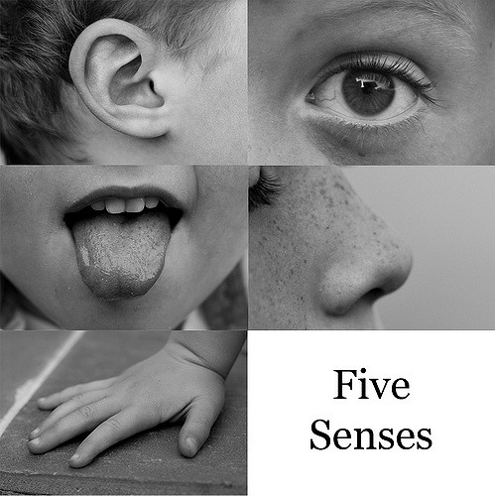
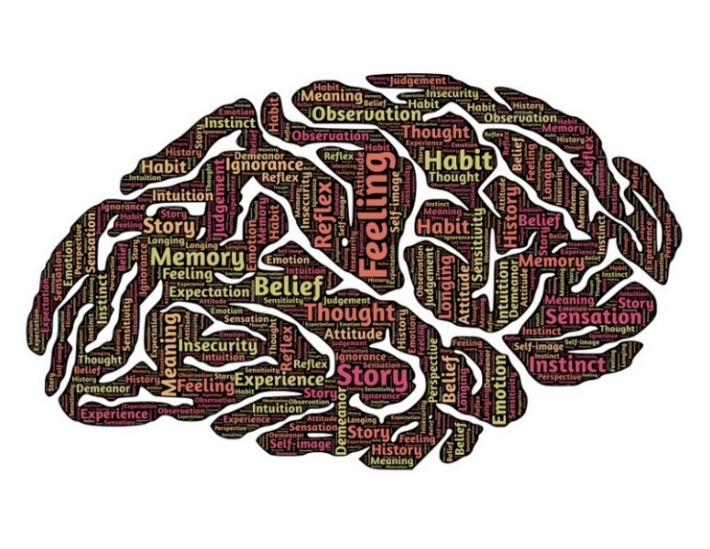
ACT Matrix
Outer
5-Senses Experiencing:
What we see, hear, touch, taste,
smell, and do with our body
Functions of outer experience can be transferred onto inner
Context of Experience
Mental Experiencing:
What we think, feel, and sense within our skin
Inner
Adapted from K. Polk, J. Hambright, & M. Webster
Notes:
Five Senses image: flickr.com
Brain image: pixabay.com

Slide 105
ACT Matrix
Stuck Loop: short-term relief but unworkable in long-run
Behaviors under aversive control
of hooks
Behaviors under appetitive control
of values
Away
Toward
Negative
Reinforcement
Positive
Reinforcement
Hooks
Values
Painful private events:
Uncomfortable thoughts, urges,
emotions and sensations
Freely chosen qualities of action:
Desired ways of behaving
(within different life domains)
Adapted from K. Polk, J. Hambright, & M. Webster

Slide 106
ACT Matrix
Outer
Behaviors under aversive control
of hooks
Behaviors under appetitive control
of values
Away
Toward
Observing
Self
Hooks
Values
Painful private events:
Uncomfortable thoughts, urges,
emotions and sensations
Freely chosen qualities of action:
Desired ways of behaving
(within different life domains)
Inner
Adapted from K. Polk, J. Hambright, & M. Webster

Slide 107
ACT Matrix
Outer
Clinical Interview
What do you do to get away (relief) from these hooks?
What could you do to move toward
(act on) your values?
Walk
Away
Toward
Noticing
Hooks
Values
Willing
What thoughts and feelings
tend to hook you (get in the way
of moving toward your values)?
What are your heart’s deepest desires
for how you want to live your life?
What do you want to stand for?
Inner
Adapted from K. Polk, J. Hambright, & M. Webster

Slide 108
Workability questions: away
First: validate short-term effects (payoffs) of negative reinforcement
Then ask:
Have any of these (away moves) ever completely gotten rid of your (hooks)?
Have any of these (away moves) made (hooks) worse over time or created new problems?

Slide 109
Workability questions: toward
What effects might this (toward move) have on your life in the short-term?
How might this (toward move) bring more fulfillment to your life in the long run?
Would you be willing to carry your (hooks) with you as you move in this direction?
If it meant living the life you long to live?

Slide 110
Case presentation
Middle-aged Latina female in therapy for depression and life dissatisfaction. She frequently makes statements such as, “I’m lazy” and “I have no self-discipline”, following-up with, “well, it’s true” or “I can’t change”. Her daily routines are dictated by a “have to” mentality, often berating herself about what she “should” be doing. She c/o feeling lonely and sad much of the time, and will smoke THC, sit on the couch, “booty-call” abusive x-BF, or attempt to fix others’ problems when hooked by such feelings. She appears more vibrant when sharing about her acts of kindness in volunteering and enjoys dancing and socializing with friends. She expresses a wish to model responsibility for her kids at home and engage in healthier behaviors.

Slide 111
ACT Matrix
Outer
Case Conceptualization
Experiential avoidance:
Cannabis use
Inactivity
Booty call
Attempts to fix others
Values-guided behavior:
Volunteering
Dancing with friends
Cleaning/organizing her home
Eating healthy & exercising
Away
Toward
Noticing
Hooks
Values
Feelings:
Lonely, sad, shame/guilt
Self-As-Concept:
“I’m lazy”, “no self-discipline”
Signs of Fusion & Pliance:
“well it’s true”, “I can’t change”
“should”, “have to”
Domains / Values:
Community: kind, helpful
Friends: connection, fun
Parenting: responsibility
Health: self-care
Inner
Adapted from K. Polk, J. Hambright, & M. Webster

Slide 112
ACT Matrix
Outer
Practice
What do you do when under the
control of these hooks?
How might this impact clients?
What does it look like (in session)
to be acting on your values?
How might this impact clients?
Away
Toward
Noticing
Hooks
Values
What thoughts and feelings
tend to hook you (get in the way of
being the clinician you want to be)?
What kind of clinician do you want
to be? What qualities do you want
to bring into the work you do?
Inner
Adapted from K. Polk, J. Hambright, & M. Webster

Slide 113
ACT Matrix Interventions
Psychological flexibility can be shaped via RFT interventions that evoke and reinforce:
Flexible context sensitivity
Ability to notice various features of context and respond to what’s most relevant
Functional coherence
Making sense of experience in accordance with goals or a given purpose
Villatte, Villatte, & Hayes, 2016

Slide 114
ACT Matrix
Outer
RFT Interventions
What have you learned from past experiences with Away moves that could be helpful going forward?
Which Toward moves would you like to be doing more of in the future?
Away
Toward
Temporal
Hooks
Values
When was the last time these hooks were present? When do you anticipate them showing up again?
When is the last time you can recall being connected to these values? What was that like for you?
Inner
Adapted from K. Polk, J. Hambright, & M. Webster

Slide 115
ACT Matrix
Outer
RFT Interventions
Where (in what situations) are you most likely to do Away moves?
Where (in what situations) are you most likely to do Toward moves?
Away
Toward
Spatial
Hooks
Values
Where are these hooks right now – up close on you or a bit further away?
Where (in what situations) do you tend to be most connected to your values?
Inner
Adapted from K. Polk, J. Hambright, & M. Webster

Slide 116
ACT Matrix
Outer
RFT Interventions
Are there any Away moves that also serve as Toward moves at times?
How are these Toward moves meaningful or fulfilling for you?
Away
Toward
Coordination
Hooks
Values
What might any of these hooks reveal that matters to you (that’s important)?
When considering your values, what vulnerabilities show up for you?
Inner
Adapted from K. Polk, J. Hambright, & M. Webster

Slide 117
ACT Matrix
Outer
RFT Interventions
Are there any Away moves that don’t have costs in the long run?
What do you do that brings meaning to your life when you’re not struggling with hooks?
Away
Toward
Distinction
Hooks
Values
If these hooks were no longer a problem, what would you be doing with your time?
What is your life like when you’re not in touch with what matters to you?
Inner
Adapted from K. Polk, J. Hambright, & M. Webster

Slide 118
ACT Matrix
Outer
RFT Interventions
Which moves bring more meaning and fulfillment into your life - Away or Toward?
Are you generally more present during your Outer or your Inner experiences?
Away
Toward
Comparison
Hooks
Values
Which hook(s) tend to push you around the most? Which are you able to hold lightly?
Which values are most dear to your heart? Which ones are not as important?
Inner
Adapted from K. Polk, J. Hambright, & M. Webster
Notes:
Comparative: evokes comparison of streams of contingencies, explore preferences

Slide 119
ACT Matrix
Outer
RFT Interventions
What effects (payoffs/costs) have these Away moves had on you and your life?
What effects might these Toward moves have on you and your life?
Away
Toward
Conditional
Hooks
Values
If you could make room for these hooks, what would that allow you to do that matters in your life?
If you were connected with these values, how might that influence your choices?
Inner
Adapted from K. Polk, J. Hambright, & M. Webster
Notes:
Conditional: orients us to intention and consequences; evokes description of behavior

Slide 120
ACT Matrix
Outer
RFT Interventions
What overarching lesson may these Away moves have to offer?
What would doing these Toward moves be in the service of?
Away
Toward
Hierarchical
Hooks
Values
How could you use any of these hooks to enrich your life in some way?
What areas of your life (love, work, play, health) are these values a part of?
Inner
Adapted from K. Polk, J. Hambright, & M. Webster
Notes:
Hierarchical: evokes linking of choices and painful private events to higher purpose

Slide 121
ACT Matrix
Outer
RFT Interventions
When you are caught in a stuck loop, what do others see you doing? What would I see?
Traveling back to a time when life was meaningful,
what do you notice? What are you doing?
Away
Toward
Deictic
Hooks
Values
If your loved one was experiencing these hooks, how would you respond? How would your loved one respond to you?
In the distant future, you’re looking back on your life, what do you want to have stood for? How do you want to be remembered?
Inner
Adapted from K. Polk, J. Hambright, & M. Webster

Slide 122
Life with the matrix
Non-judgmentally notice when you are:
In your head vs. in the world
Moving toward values vs. away from pain
Caution: “toward/away” is NOT “good/bad”
Goal is to build psychological flexibility
Choosing to do what matters, even in the presence of difficult experiences

Slide 123
Therapeutic relationship
Stimulus/Response
Flexible Inflexible
Environmental
Stimulus/Response
Model Evoke Reinforce
Developmental/ learning history
Therapeutic stance
Sociocultural
Relations to private events
Verbal/ non-verbal
behavior
Therapeutic alliance
Function of stimulus is contingent upon context
Images: pixabay.com

Slide 124
Act: informed consent
Collaborative and active form of therapy
“Learn how to relate to difficult thoughts and feelings in a way that they have less impact and influence over you”
From “feel better” to “get better at feeling”
“Clarify what matters to you and take steps to bring more fulfillment into your life”

Slide 125
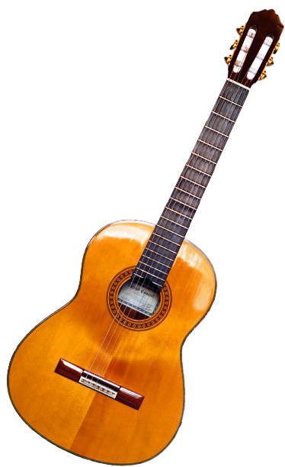
ACT: Informed Consent
Can be uncomfortable and challenging at times – just like learning any new skill
Images: pixabay.com

Slide 126
Act: goal collaboration
Identify/prioritize client’s values-guided behavioral goals at onset of therapy
If symptom reduction is client’s goal, ask: “Okay, if you were feeling better, then what would you be doing differently?”
Get permission to press “pause” when sessions veer off course

Slide 127
Assessment
Acceptance and Action Questionnaire (AAQ-II)
7-item scale that measures psychological inflexibility (esp. experiential avoidance)
Demonstrated reliability/validity in research
Bond, et al., 2011
ACT ADVISOR
David Chantry
ACT Vowels Assessment (AVA)
Lasprugato, 2017

Slide 128
Therapeutic stance: ten tips
Treat each session as if it were the last
Most common number of sessions = 1
Assume that change is possible quickly
Focus is the client’s life, NOT your agenda
Don’t argue, don’t persuade, don’t coerce
Ask, rather than suggest, that they be willingly vulnerable to try on new behaviors

Slide 129
Therapeutic stance: ten tips
Reason-giving/rationalizing are obstacles
The issue is workability, not reasonableness
Compassionately confront unworkable agendas (via functional analysis)
When in doubt, ask yourself or the client:
What is this in the service of?

Slide 130
Therapeutic stance: ten tips
We can’t rescue clients from the challenge and difficulty of growth
Let go of the need to fix them
They’re NOT broken, but rather stuck
The client’s experience is NOT the enemy
What matters is how the client relates or responds to his/her experience

Slide 131
Therapeutic stance: ten tips
Never protect yourself by moving one up on client
You are both climbing your own mountains
You just have better view of obstacles on client’s mountain
* Notes
Image: imgur.com
Notes:
*2009 APA survey found that 87% of psychology graduate students reported experiencing anxiety, and 68% reported symptoms of depression. Even suicidal thoughts – with a prevalence of 19% - were relatively common.

Slide 132
Therapeutic stance: ten tips
8. Watch for your own experiential avoidance
Changing topics or cutting them off
Trying to fill the silence with language rather than just sitting with pain
Telling them “it’s okay” when it’s not
Letting them perseverate (i.e. get lost in Self-As-Content) without bringing them back to present moment to facilitate defusion

Slide 133
Therapeutic stance: Ten Tips
If client is trapped, frustrated, confused, afraid, angry or anxious:
This is exactly what needs to be worked on, and it is here now
Turn the barrier into an opportunity
If you feel trapped, frustrated, confused, afraid, angry, or anxious:
You can use this to humanize your work
Open up to it

Slide 134
Therapeutic relationship
Aim is to continually shape the client’s behavior as it relates to ACT hexaflex
Model ACT in the therapy room
Evoke psychological flexibility in client
Reinforce client’s workable behavior in and out of therapy

Slide 135
Modeling ACT
AWARE
3. in the therapeutic relationship with full awareness?
Present Moment
Acceptance/
Willingness
Values
Psychological
Flexibility
OPEN
ENGAGED
Defusion
Committed
Action
1. Am I open to having my private experience…
Self-As-Context
2. as I engage my clinical values…

Slide 136
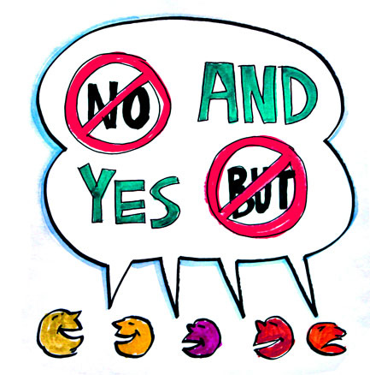
Validate and Evoke
Present: Is that here now?
Self: Who’s noticing this story?
Defusion: So there’s this thought…
Acceptance: Can you stay with that feeling?
Values: How is that important to you?
Action: What could you do to move toward…?
Workability: How has that worked for you?

Slide 137
Reinforcement matters
Functional Analytic Psychotherapy (FAP)
Two studies implementing “Fast Friends” procedure for generating closeness
Self-disclosure evoked by therapist and then reinforced with therapeutic responsiveness resulted in improved self-disclosure and more connectedness in therapy and other relationships compared to evoking alone
Haworth, et al. 2015
Notes:
Haworth, Kevin, et al. "Reinforcement matters: A preliminary, laboratory-based component-process analysis of Functional Analytic Psychotherapy’s model of social connection." Journal of contextual behavioral science 4.4 (2015): 281-291.

Slide 138
Takeaway: Six Magic act Tricks
Make the most out of each encounter
Ground the work in here-and-now
Use language as intervention and…
Therapeutic relationship as agent of change (model, evoke, reinforce)
Shape and track psychological flexibility
Tailor to client and context

